Slide 1

Regional Workshops:
Collaborative Professional Development for
In-Service Librarians in South Carolina, USA
From the book,
Global Action on School Library Education and Training
Dr. Karen Gavigan
School of Library and Information Science
University of South Carolina, USA

Slide 2

What Are Regional Workshops?
Day-long workshops conducted for South Carolina school librarians since 2016
Conducted in four locations around the state – four regions of South Carolina
Free to participants

Slide 3
Workshop Partners
School of Library and Information Science (SLIS) - University of South Carolina (USC)
South Carolina Department of Education (DOE)
South Carolina Association of School Librarians (SCASL)
Follett School Library Solutions

Slide 4
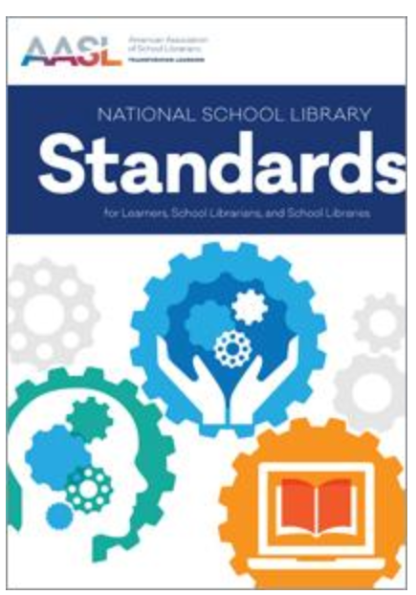
Content Covered
Information / updates from the SC DOE about new statewide initiatives, such as Read 2 Succeed
Reports from SCASL and SLIS
Breakout sessions on topics such as:
  New American Association of School Librarians’ Standards
  Facilities - Makerspaces / Learning Commons
  Using Graphic Novels across the Curriculum
  STEM Resources
  Best Websites for Teaching and Learning
  Building Collaborations Between School & Public Libraries
  Advocacy
  The “Write” Stuff for School Librarians

Slide 5
Benefits for Partners and Participants
Partners
Participants
Helps SLIS develop a stronger presence in the state / enhanced relations with USC alumni statewide
Provides the SC Department of Education with personal contact in the field while providing the latest news / intiatives
Helps SCASL increase membership / network with current members
Follett – builds their relationships with customers
Support system for themselves & their school library programs
Best practices regarding resources, pedagogy, and curriculum,
Networking opportunities
Learn the latest news to take back to their schools
Receive credits toward recertification of their school library licenses

Slide 6
Feedback from a Partner
Regina H. Thurmond, Education Associate, SC Department of Education Office of Educator Effectiveness and Leadership Development, stated:
“What an incredible way to empower and support our school librarians across the state with best practices and strategies to help lead their school communities. This unique collaborative initiative offers expertise from some of the best in the field and exemplifies the power of teamwork!”

Slide 7
Connection to the
IFLA School Library Guidelines
Guidelines 3.5.3 Leadership and Collaboration
  “A school librarian should collaborate with other school librarians to extend and continue their professional development and learning.”
  (IFLA School Libraries Section Standing Committee 2015, 28)

Slide 8
Questions?
kgavigan@mailbox.sc.edu

