Slide 1
Copyright REFORM in Myanmar
Mya OO Director National Library of Myanmar

Slide 2
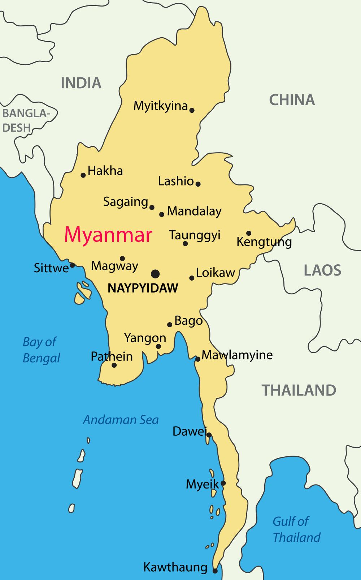
Myanmar facts and figures
South-east Asia
51.5 million people
93% literacy rate
150+ universities
5,000+ libraries
November 2015-first democratic election after 50 years military rule
New constitution, new courts, new trade agreements, new legislation
New copyright law!

Slide 3
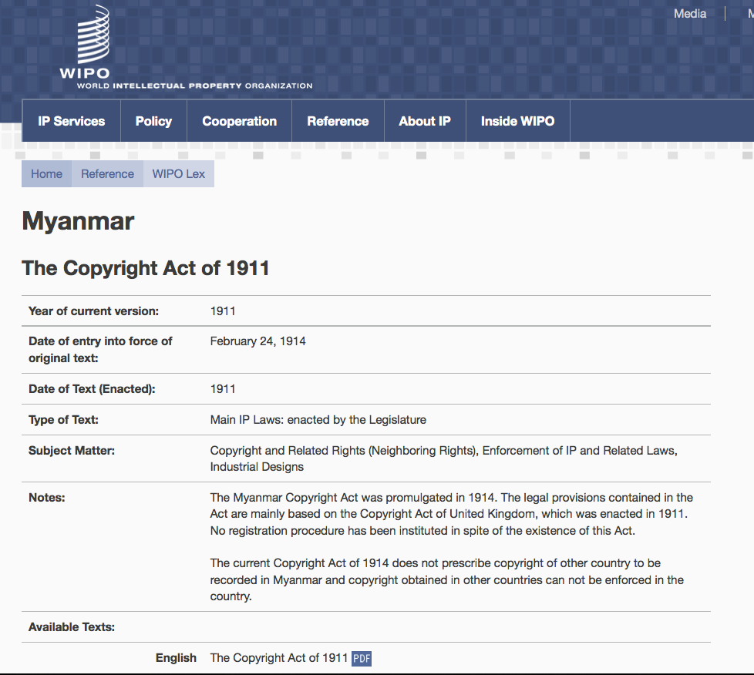
Current copyright law
National law Copyright Act (1914)
International agreements
Joined WIPO (2001) NO Berne Convention
NO WIPO Internet treaties
Joined WTO (1995) TRIPS Agreement – LDC waiver until 2021
Regional and bi-lateral trade agreements e.g.
- Association of Southeast Asian Nations (ASEAN)
- US Trade & Investment Agreement (2013)
Notes:
3

Slide 4
Current copyright law
No explicit exceptions for libraries
Fair dealing for private study, research, criticism, review
Copying for certain educational purposes
Term of protection: life of author + 30 years
No protection for foreign works (no Berne)
Source above: WIPO Study on Copyright Limitations and Exceptions for Libraries and Archives prepared by Kenneth Crews (2015)

Slide 5
Proposed copyright law
Lead agency: Ministry of Science and Technology (MOST) – now in Ministry of Education
Draft law under development since 2012
9 July 2015: draft law published in Kyemon national newspaper
July 2016: draft at Attorney General’s Office for review and possible amendment
Next it will be submitted to Parliament (Hluttaw)

Slide 6
Proposed copyright law
Key recommendations on draft law by EIFL (2013-2015), in cooperation with MLA:
allow libraries to make digital copies, including for preservation allow use of digital technologies for education and teaching
add library and education exceptions to circumvention of technological protection measures (TPMs)
allow inter-library document supply use of orphan works
translation of works not available in minority languages for
study purposes
Recommendations 1/2

Slide 7
Proposed copyright law
Key recommendations (continued):
allow the making of accessible format copies for persons with
all disabilities
keep fair dealing in the new law
permit libraries to acquire works from abroad (international
exhaustion)
 introduce a limitation on liability for librarians
Recommendations 2/2

Slide 8
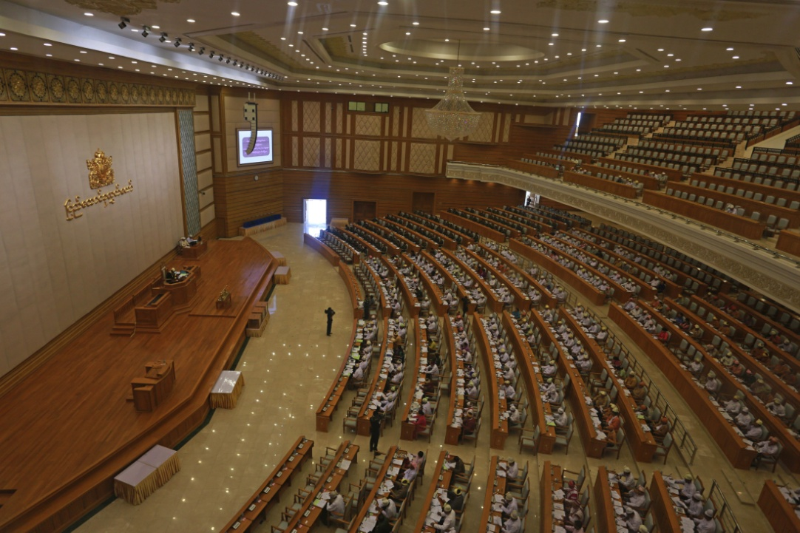
Proposed copyright law
Good news – some recommendations accepted e.g. digital copying
We await next draft at Parliament (Hluttaw)
Together with EIFL, we will monitor the
process and submit
comments as needed

Slide 9
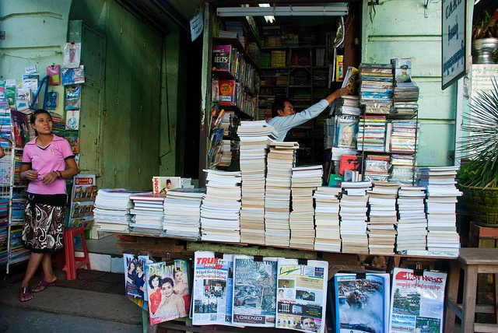
The future
Big changes ahead:
Whole new IP infrastructure planned – national IP office, IP courts, enforcement
For the first time foreign works will be protected – change in copy culture, higher textbook prices?
Copyright education essential for librarians
Librarians need to be involved in policy-making

Slide 10
The future
Challenges for libraries in Myanmar:
Role of libraries have been tried to promote in many ways
Low bandwidth - but no Internet at all in libraries until 2013! (before EIFL e-Library Myanmar project)
Difficult for institutions to get static IP addresses due to the telecommunication system
Unreliable electricity supply esp. in summer
Great enthusiasm and desire for change among librarians and faculty

Slide 11
Thanks to EIFL for supporting library copyright reform in Myanmar
Daw Mya Oo, National Library; Teresa Hackett, EIFL; Jonathan Band, Counsel Library Copyright Alliance in Nay Pyi Taw, May 2015

Slide 12
More information
Myanmar Library Association (MLA) on Facebook
Getting ready for Myanmar’s new copyright system
eifl.net/news/getting-ready-myanmars-new-copyright-system
eLibrary Myanmar Project
www.eifl.net/eifl-in-action/elibrary-myanmar-project

Slide 13
Thank you.

