Slide 1
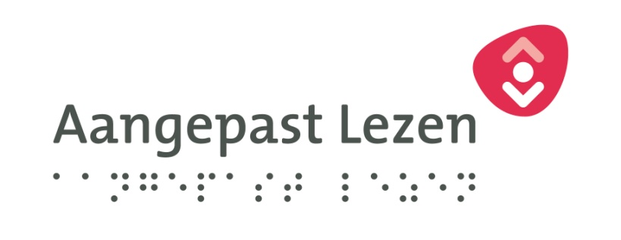
Accessible websites, a necessity?
Issues dealt with in making online services for the print disabled accessible

Slide 2
Accessible website for National Centre for Adapted reading
2007, founding of the National Centre for Adapted Reading (Stichting Loket aangepast lezen)
Front office, customer organization, for people with print disabilities in the Netherlands and part of the branch of Public Libraries instead of a special branch outside the network
Production, reproduction and distribution done by producing organizations Dedicon and CBB
New website needed to be created

Slide 3
What about the New website
A rather rudimentary knowledge on Accessibility (W3C guidelines)
Organization Accessibility, the accredited foundation to test websites according the W3C guidelines: advice on guidelines:
Technical and redaction
Selecting a website builder chosen who could built websites according to W3C
a functional and a graphic design was put together:
Mainly information oriented on products and services provided and organization itself
Very simple search engine to search in the catalogue (braille and talking books) and no possibilities to order online, technique not available at the time

Slide 4
new website
2 years of experience, further development
2010, again a new website, why?
Accessibility doesn’t mean usability, user experiences were gathered
End user panel installed, with representing people (about 25) with different print disabilities: blind, ill-sighted, dyslexia etc.
Development of on-line catalogue system, for ordering de talking books, books in braille
Introduction of streaming services on the website and other players
Again a functional and graphical design, by a new selected developer (company) for the purpose of two integrated websites:
An open, public part for potential and new clients with information about the services, products and organization
A part behind a log-in, for clients only, with personalized pages, bookshelves and possibilities to order books online and streaming facilities
Developed by partner Dedicon, a web based version of our library automation system Vubis (INFOR)

Slide 5
new website 2
Both websites where developed with user advice and testing on graphic and functional design
Both websites checked by organization Accessibility on W3C guidelines
First catalogue world wide that was tested on W3C guidelines!
Embedded Daisy online player
Some exceptions were given after some good discussions with Dutch board on the W3C guidelines
First website in the Netherlands which could comply to all guidelines (142), public part
User panel still plays a role in checking on any adjustment or development done on the website
Only small adjustments were done since then

Slide 6
Renewed website
This autumn the current website will again be renewed
To much (useless) information, which does not appeal to new customers
Other navigation structure
More products there like a in window shop and to try straight away
Direct ordering and shopping basket, for products so new clients don’t have to wait for two or three days before getng started (online)
Nearby future: new user web based interface, Iguana by INFOR
No longer two separate websites needed because Iguana interface has been developed on Accessibility W3C guidelines

Slide 7
Conclusions
W3C guidelines are not that to difficult to apply on. Much more is possible nowadays then a couple of years ago
Chose a developer/company who can built according to those guidelines, with some proven record on that
Make use of (end) user panels, both blind/ill-sighted and dyslectic
Blind/ill-sighted and dyslectic may have different needs for a website, but both groups can be served on a same website
Advocacy on Accessibility: We are in the country of Louis Braille, information (content) has become more accessible over the years, but what about the way to get there? Still a lot of work to be done!
In the Netherlands: this autumn a declaration is signed by Bibliotheek.nl (Dutch digital platform for public libraries), Accessibility and National Centre for Adapted Reading for making all the websites for public libraries (WAAS = Website as a services and their components accessible.

Slide 8
Thank you / Merci
Questions?

