Slide 1
Growing Daisies
streaming daisy audio books through local Dutch public libraries

Slide 2
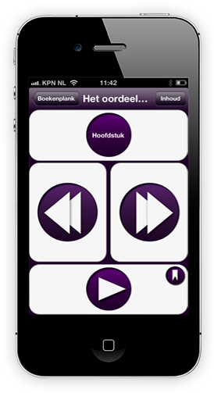
Adapted Reading in the Netherlands
it is a special lending service in a special format
for a specific group of people,
National Center for Adapted Reading
30,000 registered persons
62,000 Daisy audio books and 10,000 braille books
Online catalogue for searching and ordering and online listening
Daisy audio on CD-rom or as stream/download (virtual personal bookshelf)
10,000 downloads of the DaisyLezer App for mobile reading
On a monthly base around 2500 users listen to books through the App
Notes:
Although the adapted reading service in the Netherlands has officially been part of the Dutch Public Library system since 2007, the use of books in alternative format (Daisy books) at the public library has been very modest indeed. Most libraries have a limited collection of Daisy titles, and they are not very popular in terms of lending numbers. On top of that the titles cannot be borrowed by just anyone, officially one should have a print disability to be able to do so. The majority of all the adapted reading done in the Netherlands is being ordered through the National Centre for Adapted Reading and being handled by another national organisation called Dedicon. So one could very well say that adapted reading is special service in a special format for a specific group of people,
But the scenery is changing rapidly, having to do with political as well as technical reasons.
Lets have look at the services and the numbers as they are now.

Slide 3
The challenge
Double the number of people who use adapted reading
Population of the Netherlands: 16.8 million people
Member of a public library: 4 million (ca. 25%)
Estimated number of people who have a print disability: 360,000
Registered members of the National Centre: 30.000 (ca. 12%)
Making the average cost per adapted library user relatively high
How come the majority of VIP gets by without adapted reading
How to reach and inform persons who cannot read print
Raise the numbers from a 30,000 to a 60,000
More integration with public libraries
Using the digital library network
Making the service less special and more integrated
Do an integrated national marketing campaign
Notes:
If we compare the number of people who use the public libraries with those who lend their books through the Centre, we as special service providers are only half as effective as the public libraries are. Look at the numbers. Making the costs of this special service relatively expensive. If we take into account the high expenses we have to make for creating the special formats such as audio and braille we are still more expensive and it leads us to doubt our assumptions about the potential numbers or in we are in the dark about how the majority of our potential costumers get by without us.
And it worries the government; they have an obligation to be able to inform all Dutch citizens and to make society and culture inclusive for everybody.
So we need to do something: and this is the challenge we have set.

Slide 4
The new library landscape
Dutch Parliament recently adopted a new public library law
Integrate the public library system with the Dutch Royal Library (KB)
Define the core functions of public libraries
to make available knowledge and information;
to facilitate learning;
to promote reading and a taste for literature;
to promote art and culture;
to organize social encounters and debate.
Tailor the current legal framework for libraries to the digital age
it defines the scope of the digital library and arranges its funding
A new national digital infrastructure for all libraries to use
Notes:
Politically we are entering a new an more positive phase in terms of our thinking about libraries. For sure public libraries are still under financial duress and many times simply at the mercy of local municipal priorities, now at least there is a laws that specifies the core functions of public libraries and sets a standard for a digital national infrastructure. The new library law has been debated passionately (in library land), and it does not please everybody; especially so since the minster does not want to guarantee the existence of at least one physical library in each of the 403 municipalities that we have in the Netherlands. But it does raise the importance of libraries in the awareness of the policy makers and gives our special library an unique starting point!

Slide 5
The new library landscape
a new national digital infrastructure for all public libraries
libraries can acquire digital services, such as:
using a new union catalogue
Single Sign On: using a central system for identification and authentication (IAM)
ordering interlibrary loans
lending eBooks (ca. 10.000 titles)
+ order books in adapted format !
Notes:
The ebooks are negotiated centrally through the library association (VOB) and the individual (independent) library can acquire this service through a national infrastructure.

Slide 6
Using the digital platform
Making use of the e-lending infrastructure
Steps in the process (non technical description)
Making the adapted reading titles visible in the national library catalogue
Placing information about the service on the local library website (including a banner which links directly to the service)
One Time Registration (declaration of reading impairment) or log in with IAM: Identity and Access Management
Pick your title add it onto your virtual personal bookshelf and read online with embedded daisy player

Slide 7
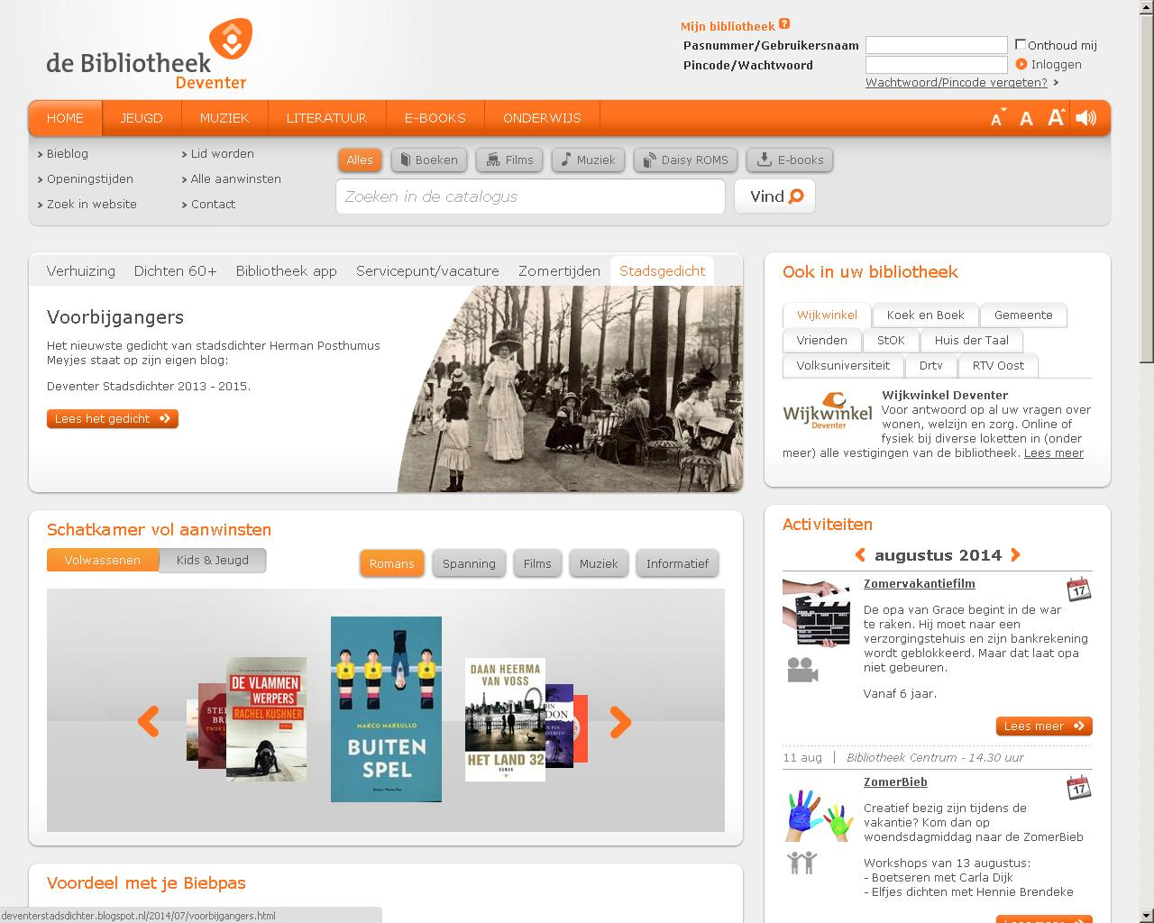
Notes:
This how a home page of a local Dutch library will present itself. Notice log in, the search banner and for instance Galary of New Titles

Slide 8
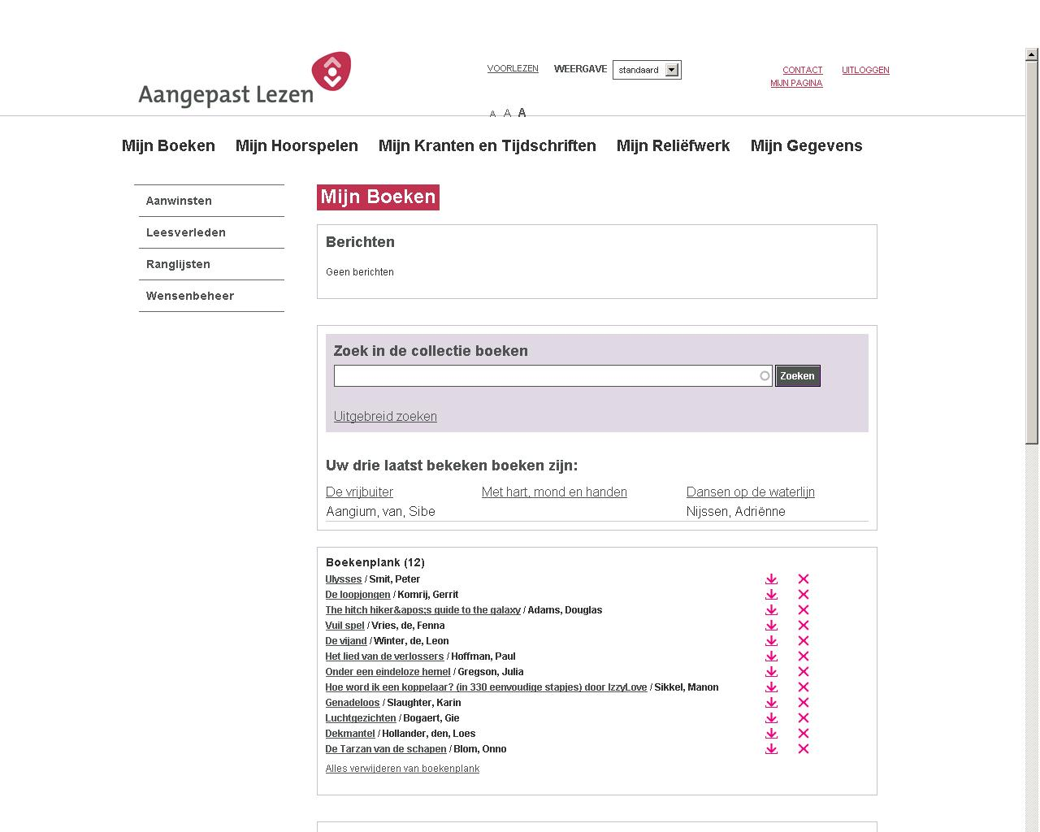

Slide 10
Results from a three month’s pilot
Testing the assumptions in 3 pilot libraries
 ☺
168 users registered for the service. More than 500 items were lent by them
Declaration of a reading problem was not an issue for people who registered
Two thirds of the respondents were under the age of 30 with reading problems such as dyslexia.
The service was judged favorably (95% of the respondents would recommend the service)
 ☹
There were no blind users in the pilot.
The accessibility of the ordering website for daisy books needs to improved
The Daisy audiobooks must be catalogued in the union catalogue by an unique identifier
Notes:
Daisy books should be catalogued not as a special edition of the printed book (as we were doing), but as a new manifestation of the work it self.

Slide 11
soft launch end of 2014
The goal is to have the service implemented at 25 libraries in the first quarter of 2015
Development of marketing and communication plan
How to reach the elderly?
How to make it easy
Public Libraries are independant and have a choice
How to convince libraries of the value of this special service?
No costs for delivering the service
Full collection
Keeping the library user inside in the local librasry
Some initial costs
implementing information and banners on local website
Training / instructing the library staff
Keeping the right holders informed
Safeguarding the special service in a public space

Slide 12
Progress and challenges ahead
from exceptional to inclusive services
Look and feel of integrated services
Decentralised presence in many local libraries
The system will generate valuable management information
Still audio-only books (daisy) People will want to use the eBooks from the library also
People prefer reading through mobile applications (app)
One reading system for all collections might be on the horizon
Notes:
Going back to were we started:. Remember we said that adapted reading is special service in a special format for a specific group of people,
But the scenery is changing rapidly, having to do with political as well as technical reasons.
We have seen the political reason (more inclusion, more people should use adapted reading) and the technical one )digital infrastructure.
And what about being special: are we moving away from that. In certain aspects yes, in others no. In terms of copyright we are still definitely exceptional, in terms of delivery we are beginning to look quite normal and inclusive. So in general we have taken a step in the direction of more inclusion, with the definite benefit of becoming more visible within mainstream library landscape and hopefully reaching more people with are (yes, still exceptional) services.

Slide 13
Thank you / Merci
Happy to take a question or two

