Slide 1
Help librarians better understand copyright：
Copyright @ Chinese Libraries
Zhao, Yan 赵 艳
IFLA International Leaders Programme, Cohort 2
National Science Library, Chinese Academy of Sciences, China

Slide 2
Project Goals
Help Chinese librarians better understand copyright
Help libraries take full advantage of the granted rights
Help libraries identify, evaluate and reduce the copyright risks
Provide guidelines for implementing library services legitimate

Slide 3
Expected Outcomes
A connected copyright network across libraries and copyright experts
A practical guidebook on copyright issues for Chinese Library services
An annual seminar for knowledge sharing, best practice showcasing on copyright issues

Slide 4
Preparation Work
Collect Data
Look for Funding and Collaboration

Slide 5
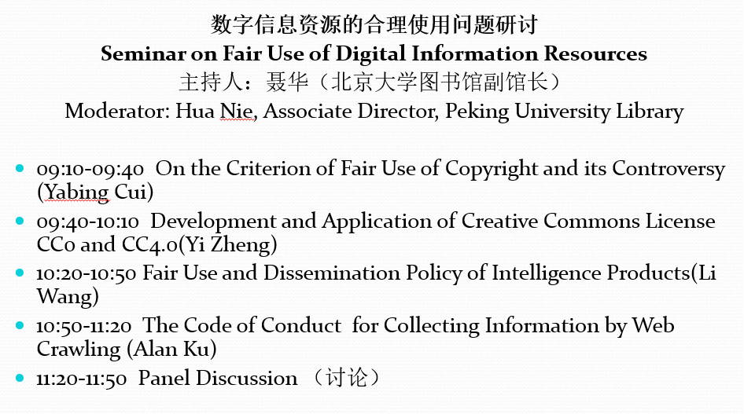
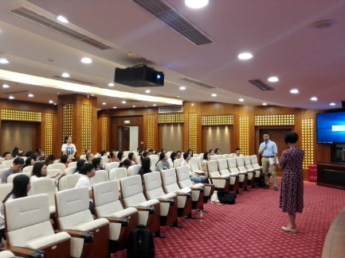
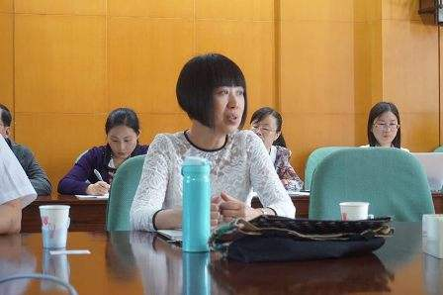
Seminars during 2018 China Fair Use Week
Part I: Fair Use of Digital Information Resources,
4th, Jun 2018, Peking University Library

Slide 6
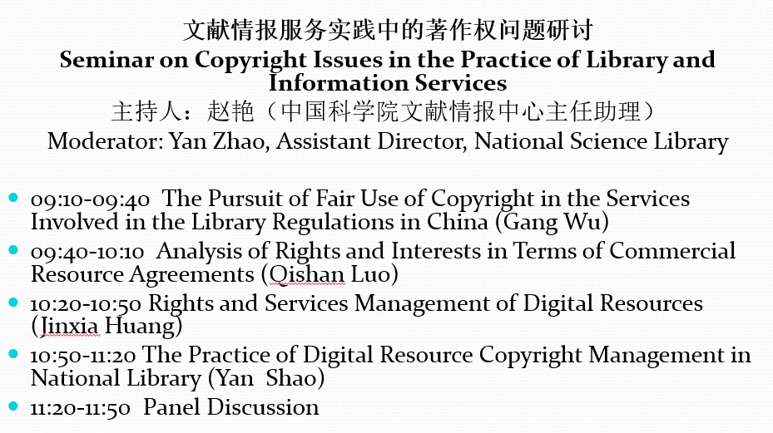
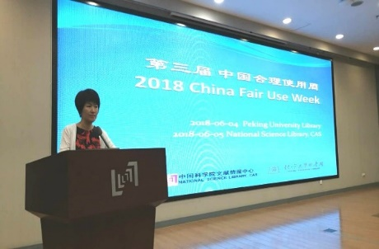
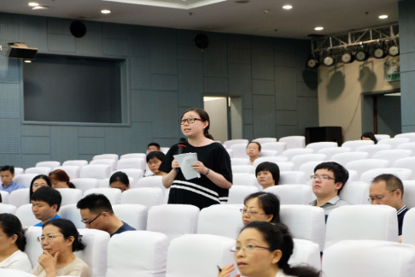
Seminars during 2018 China Fair Use Week
Part II: Copyright Issues in the Practice of Library and Information Services
5th, Jun 2018, National Science Library

Slide 7
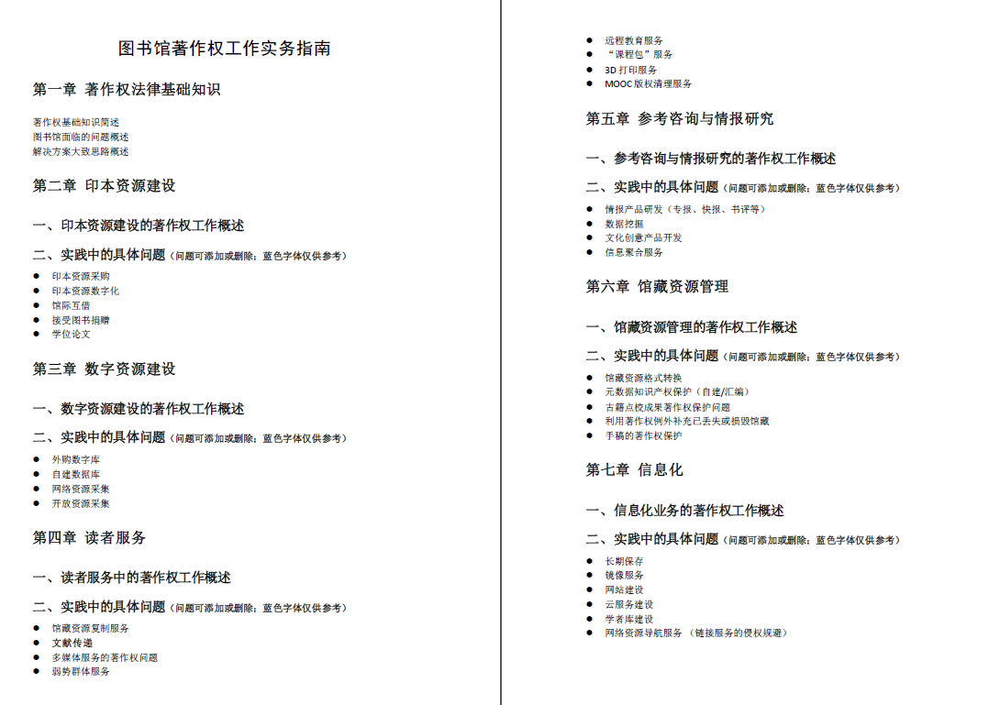
Practical Guidebook on Copyright for Chinese Librarians
Chapter 1. General knowledge of Copyright and Library-related copyright issues
Chapter 2-7. Practical issues sorted in accordance with library business workflow

Slide 8
Connected copyright network
Updating directory + real-time discussing group
Participants throughout Chinese libraries
Includes copyright experts from LIS and Law research

Slide 9
Next Step
Publish the guidebook.
Promotion and training.
Keep connections and update.

Slide 10
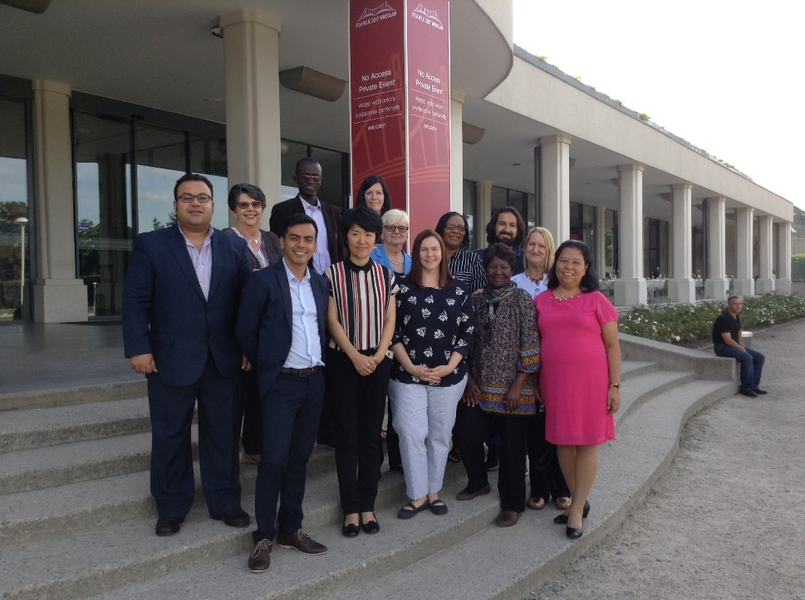
Thank you!
zhaoyan@mail.las.ac.cn

