Slide 1
INTERNATIONAL ADVOCACY PROGRAMME
LIBRARIES, DEVELOPMENT, AND THE UN 2030 AGENDA
TOPIC 6: BUILDING CONFIDENCE – UNDERSTANDING THE RESOURCES AVALIABLE TO SUPPORT ADVOCACY

Slide 2
For trainers
If you edit this file, please change the file name to show the region and the new date
Delete the word [Master] from the file name
Insert the region, eg Asia, Africa, Europe, LAC
Change the date, using format YYYYMMDD
Use underscore [ _ ] to link the elements of the file name
IFLA_IAP_Topic6_SupportingResources_[Region]_YYYYMMDD

Slide 3
Resources to help you
UN resources…
IFLA resources…
NGO resources…
Corporate resources…
Image: https://letztalkbiz.ca

Slide 4
Cinema ad: https://www.youtube.com/watch?v=7V3eSHgMEFM

Slide 5
Hatleback, M. (2015). Five things you need to know about the SDGs. http://www.cmi.no/news/?1592-five-things-you-need-to-know-about-the-sdgs

Slide 6
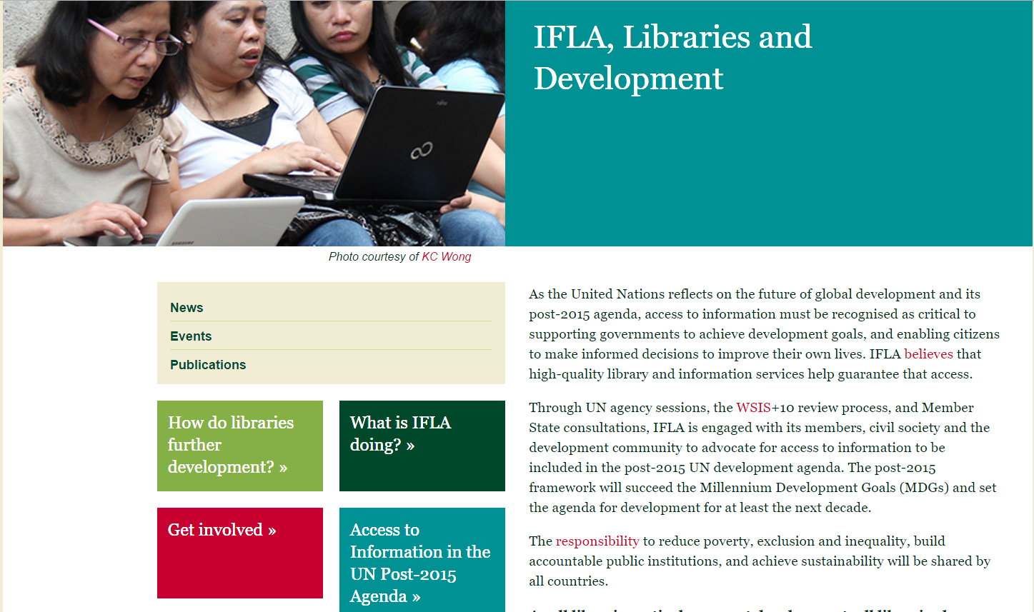
IFLA: libraries and development http://www.ifla.org/libraries-development

Slide 7
UN Open Working Group on Sustainable Development https://sustainabledevelopment.un.org/owg.html

Slide 8
Transforming our world: The 2030 Agenda for sustainable development https://sustainabledevelopment.un.org/content/documents/21252030%20Agenda%20for%20Sustainable%20Development%20web.pdf

Slide 9
Sustainable Development Solutions Network (SDSN) (2015). Getting started with the SDGs: A guide for stakeholders http://unsdsn.org/wp-content/uploads/2015/12/151211-getting-started-guide-FINAL-PDF-.pdf

Slide 10
Sustainable Development 2015: Advocacy toolkit http://www.sustainabledevelopment2015.org/index.php/engagement-tools/advocacy-toolkit

Slide 11
United Nations: Goal 16 Advocacy Toolkit https://sustainabledevelopment.un.org/content/documents/9935TAP%20Network%20Goal%2016%20Advocacy%20Toolkit.pdf

Slide 12
Water Aid (UK): Global Goals Toolkit (Goal 6) http://www.wateraid.org/uk/what-we-do/policy-practice-and-advocacy/research-and-publications/view-publication?id=1d43a620-c800-41d4-9dee-0a3171ced923

