Slide 1
Resources for Implementing the IFLA School Library Guidelines
Module 4
Digital Resources of a School Library
Part 1
(From Chapter 4 of the Guidelines)
IASL / IFLA Joint Committee
iflajcproject@gmail.com

Slide 2
Project Overview
Project objective:
To develop a module set of training materials for school library program development that support the new IFLA School Library Guidelines.
Developed by members of the Joint Committee of IASL and IFLA

Slide 3
Project Modules
Six modules, one for each chapter in the Guidelines
Some modules have more than one presentation
Presentations - Voice-over PowerPoints - some modules will also include webinars or videos
Accompanying list of resources provided with each module
All materials will be available online at the IFLA and IASL websites
Flash drives with module content available upon request

Slide 4
Module Four – Digital Resources
“The school library serves an important function as a significant access point to our information-based society. It must provide access to digital information resources that reflect the curriculum as well as the users’ interests and culture.”
IFLA School Library Guidelines
Chapter Four
4.3.2 Issues related to digital resources

Slide 5
Introduction – Digital Resources of a School Library
1.2.2 Introduction to contextual factors
A selection of digital resources hand-picked for school librarians around the world
Spanning grade levels and age range
User friendly and internationally accessible
Chosen for the widest possible audience
Selected with school librarianship in mind

Slide 6
Best Websites
1.2.9 The challenges of the changing environment
Best Websites for Teaching & Learning foster the qualities of innovation, creativity, active participation, and collaboration. They are free, web-based sites that are user friendly and encourage a community of learners to explore and discover.
American Association of School Librarians Best Websites for Teaching and Learning

Slide 7
Online Presentation Resources
1.2.9 The challenges of the changing environment

Slide 8
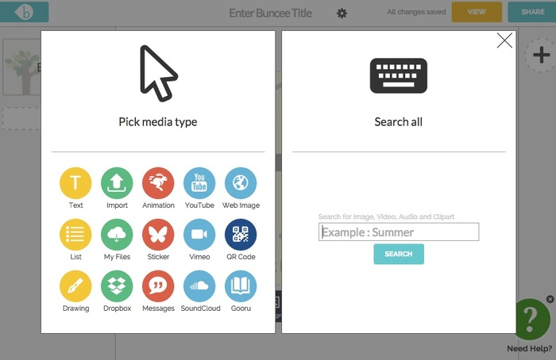
Online Presentation Resources
1.2.9 The challenges of the changing environment
Buncee

Slide 9
Online Storytelling Resources
1.2.9 The challenges of the changing environment

Slide 10
Online Storytelling Resources
1.2.9 The challenges of the changing environment

Slide 11
Online Storytelling Resources
1.2.9 The challenges of the changing environment

