Slide 1
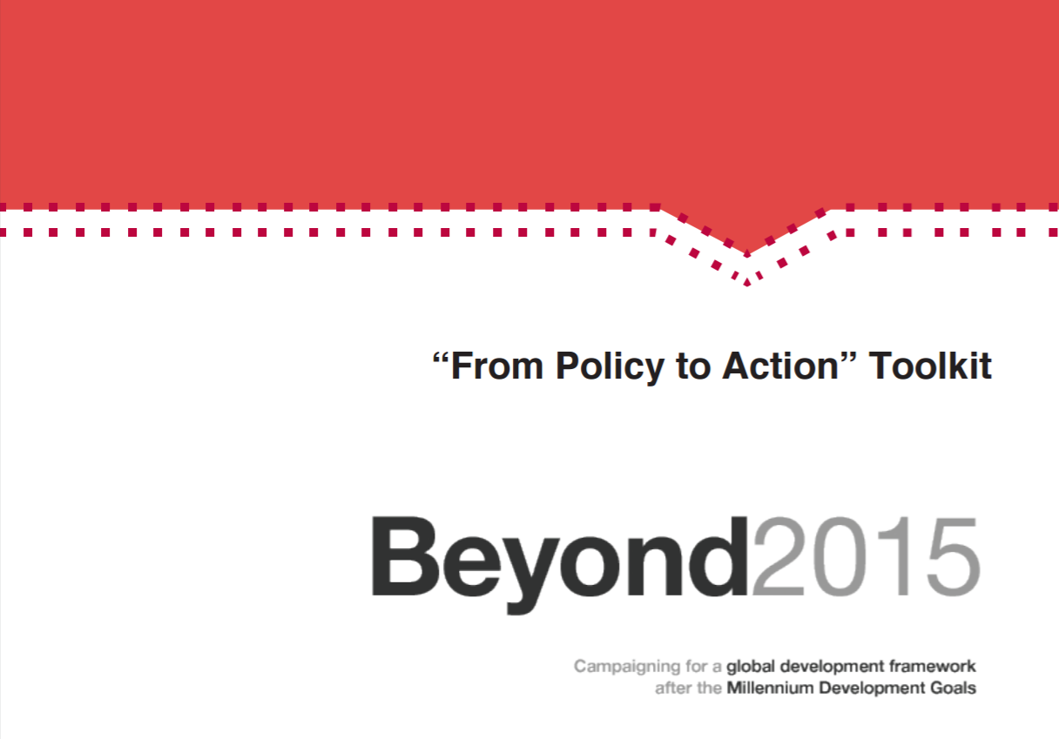
Beyond 2015: From policy to action toolkit http://www.beyond2015.org/sites/default/files/EN%20Beyond%202015%20Policy%20to%20Action%20Toolkit.pdf

Slide 2
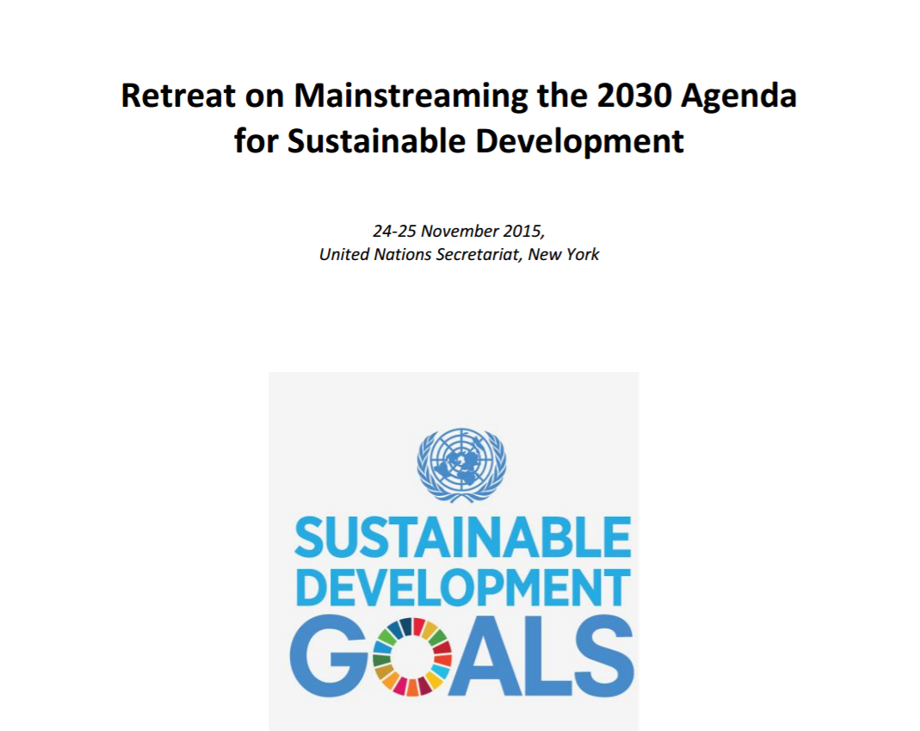
Retreat on mainstreaming the 2030 Agenda for Sustainable Development https://undg.org/wp-content/uploads/2015/12/Summary-of-Retreat-on-Mainstreaming-17-December-2015-Final.pdf

Slide 3
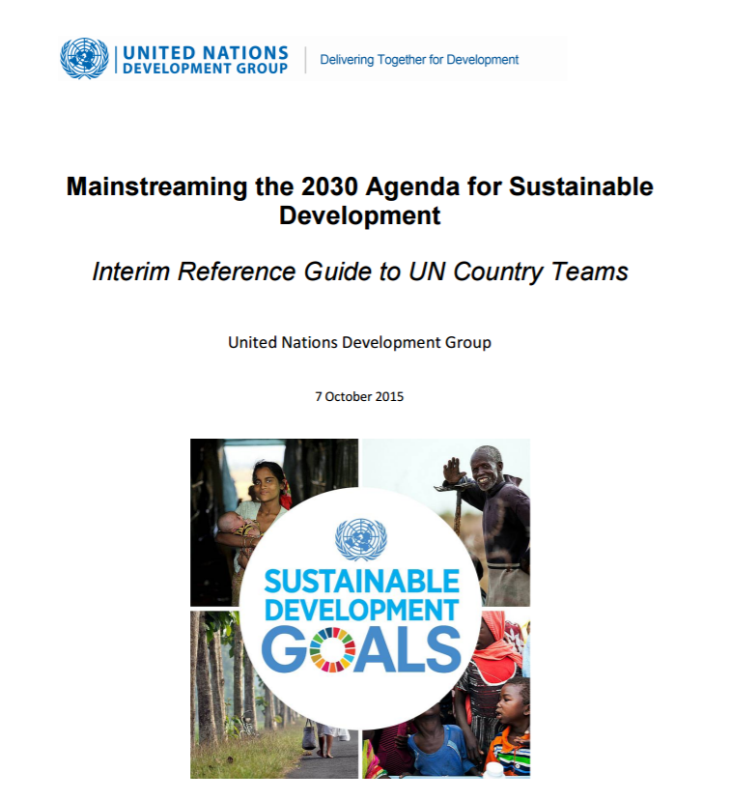
Mainstreaming the 2030 Agenda for Sustainable Development:
Interim reference guide to UN country teams https://undg.org/wp-content/uploads/2015/10/Mainstreaming-the-2030-Agenda-UNDG-Interim-Reference-Guide-to-UNCTs-7-October-2015.pdf

Slide 4
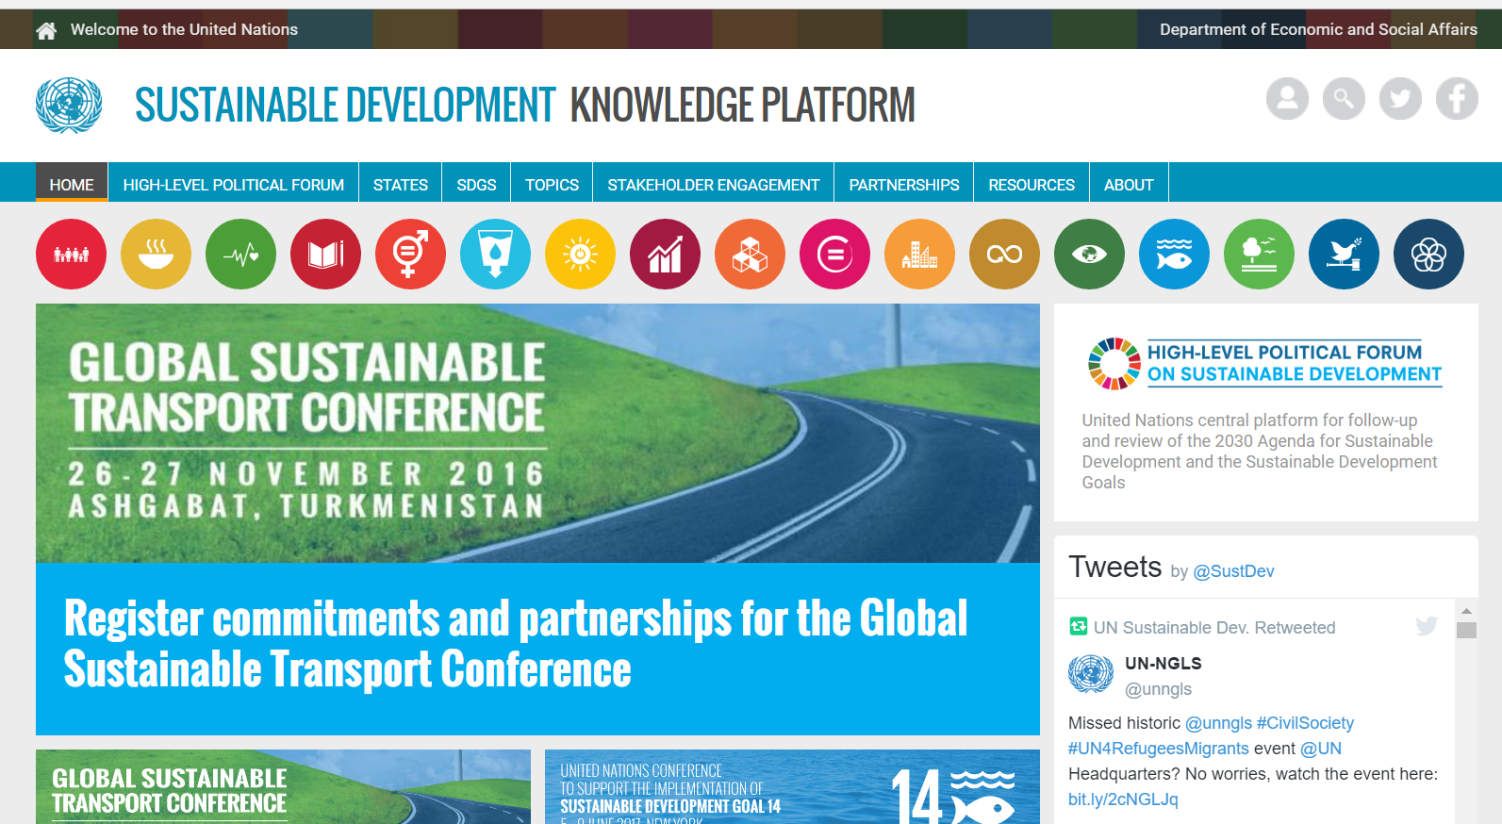
SD Knowledge Platform: partnerships, resources, topics, SDGs with links etc https://sustainabledevelopment.un.org/

Slide 5
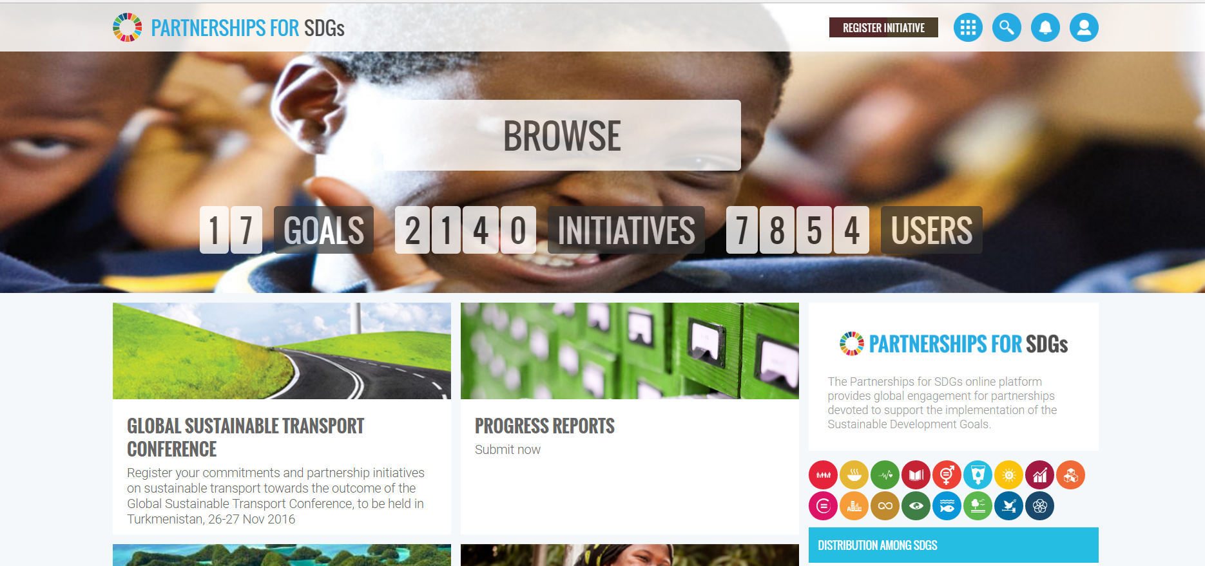
Partnerships https://sustainabledevelopment.un.org/partnerships/

Slide 6
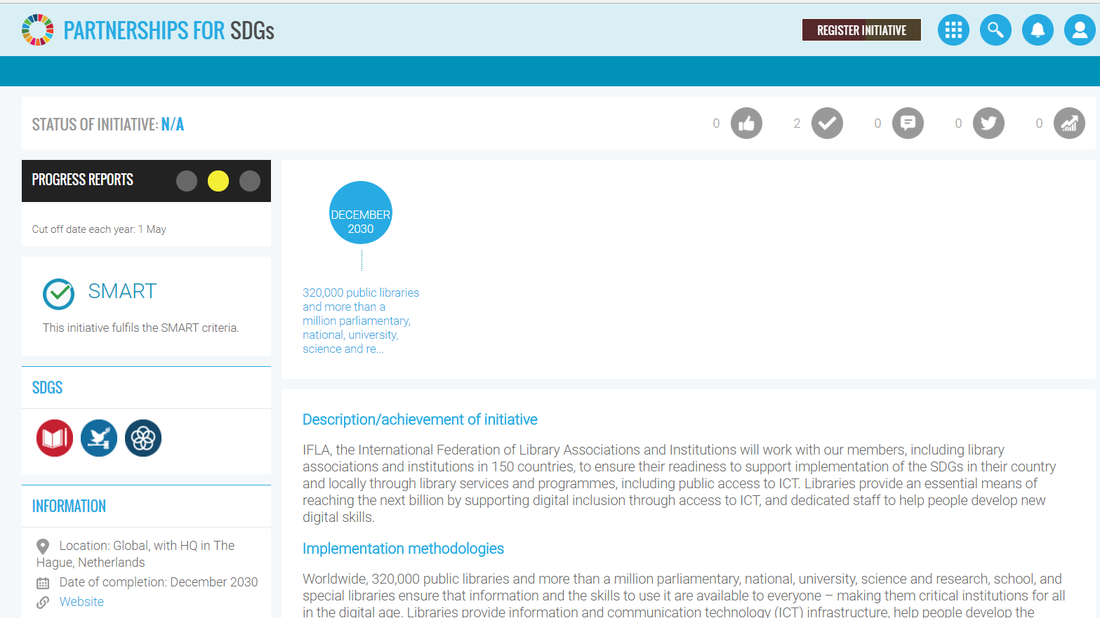
Knowledge platform: IFLA
Contribution of libraries by Dec 2030 https://sustainabledevelopment.un.org/partnership/?p=10909

Slide 7
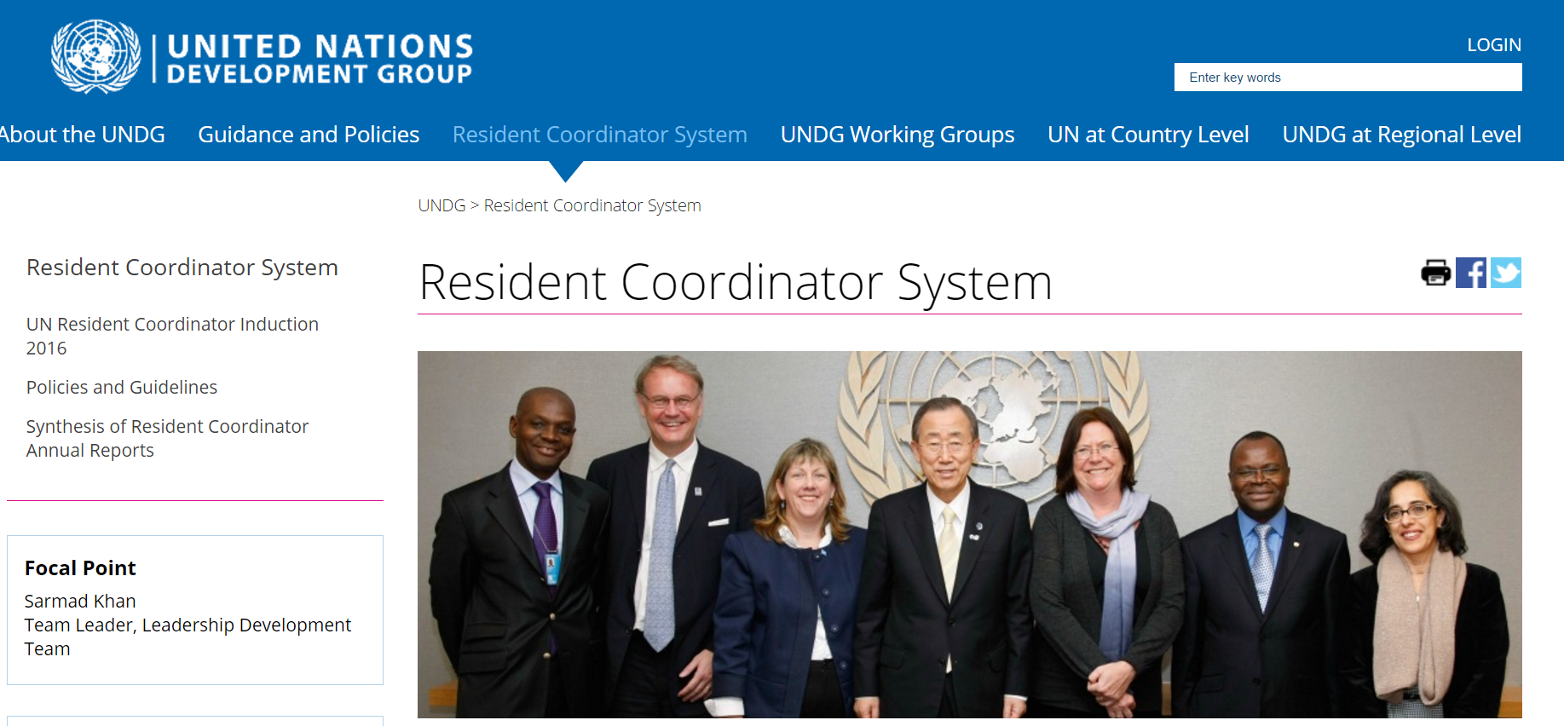
UN Development Group (UNDG) https://undg.org/home/resident-coordinators/

Slide 8
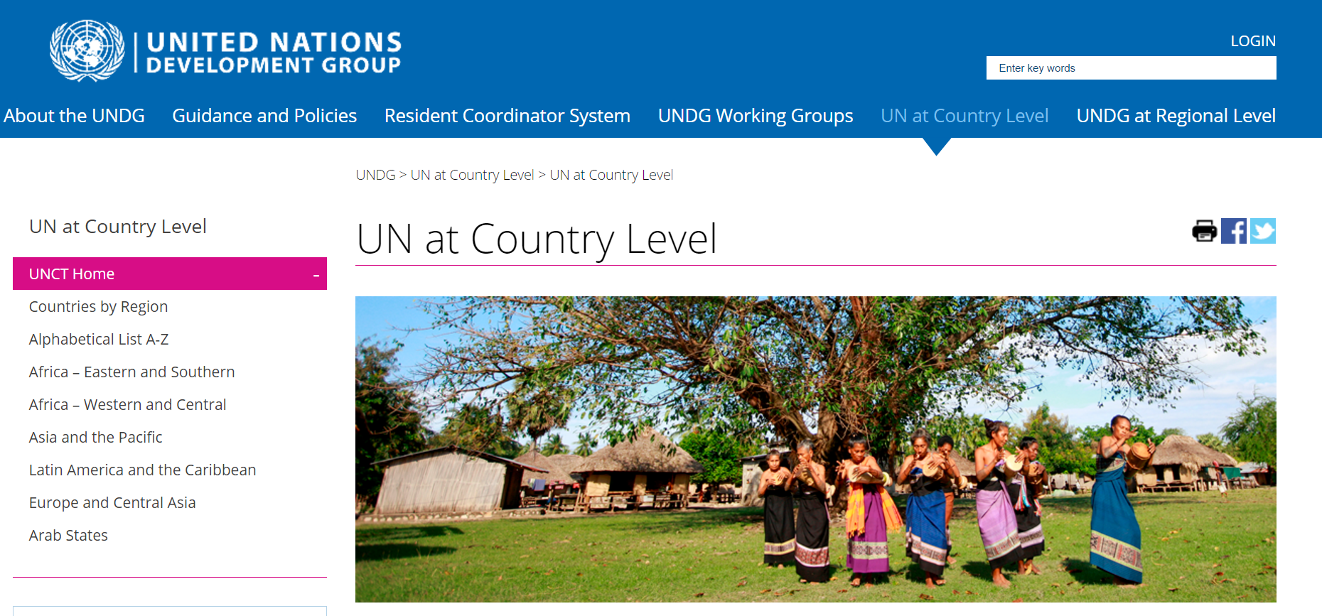
UN at country level https://undg.org/home/country-teams/unct-home/

Slide 9
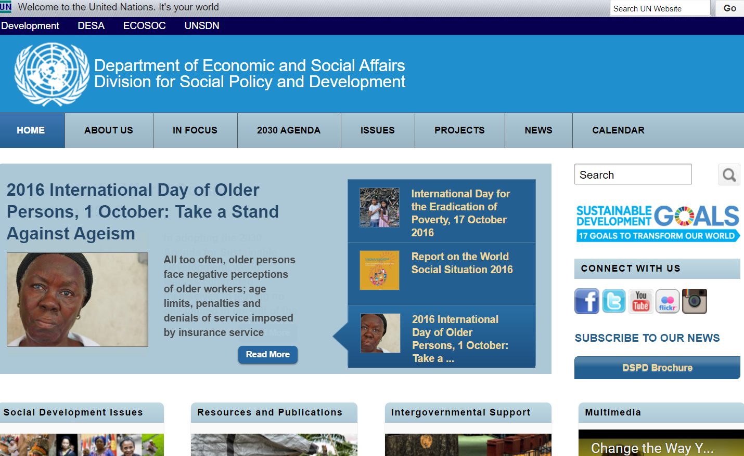
United Nations Social Policy and Development (DESA/DSPD) https://www.un.org/development/desa/dspd/

