Slide 1
UN Global Compact https://www.unglobalcompact.org/

Slide 2
UN Global Compact Australia http://www.unglobalcompact.org.au/

Slide 3
Local Government SDG app https://www.uclg.org/en/media/news/new-app-has-been-released-what-local-governments-need-know-about-sdgs

Slide 4
CAFOD (2015). Sustainable Development Goals: Action towards 2013. http://www.together2030.org/wp-content/uploads/2016/01/cafod_sdg_single.pdf

Slide 5
OECD (2015). OECD and the Sustainable Development Goals: Delivering on universal goals and targets. http://www.oecd.org/dac/sustainable-development-goals.htm

Slide 6
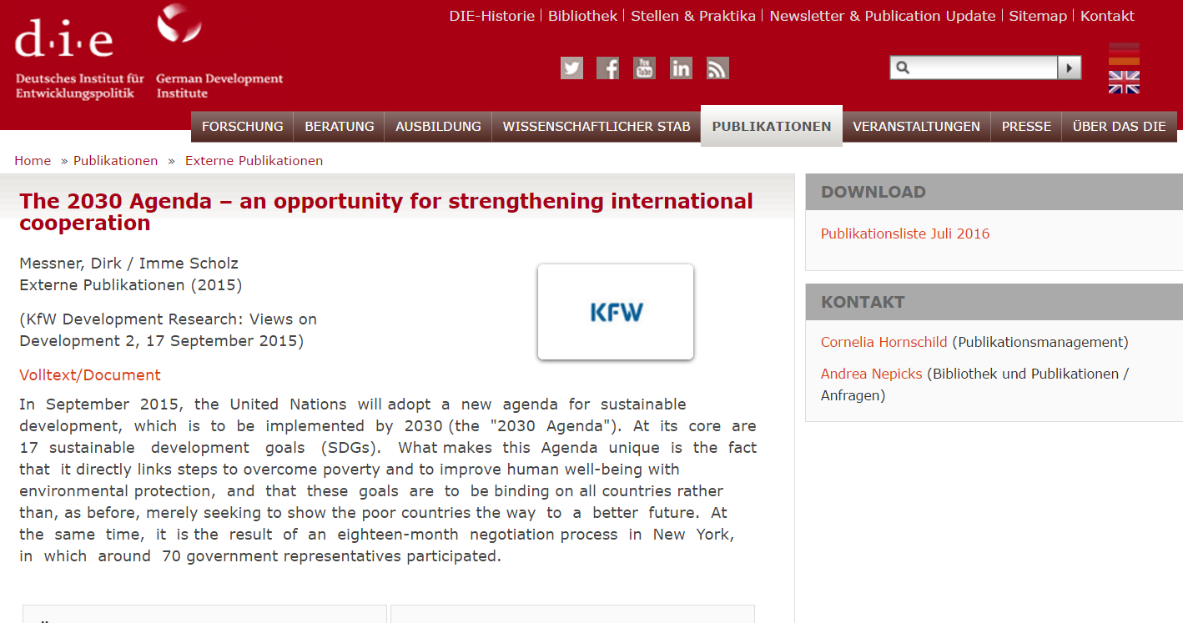
Messner, D. & Scholz, I. (2015). The 2030 agenda: An opportunity for strengthening international cooperation. KfW Development Research: Views on Development, 2, 1-3. https://www.die-gdi.de/externe-publikationen/article/the-2030-agenda-an-opportunity-for-strengthening-international-cooperation

Slide 7
National Development Plans
Jamaica: Vision 2030 http://www.vision2030.gov.jm/Portals/0/NDP/Executive%20Summary.pdf
http://www.vision2030.gov.jm/Portals/0/NDP/Vision%202030%20Jamaica%20NDP%20Full%20No%20Cover%20(web).pdf

Slide 8
International standards and sustainable development http://www.iso.org/iso/sustainable_development

Slide 9
The Age: our cities…. http://www.theage.com.au/comment/un-goals-our-cities-hold-the-key-to-a-sustainable-future-20150925-gjuv13.html

